Slide 1
design research
designing for digital storytelling forms of visualization working towards a prototype
Chemical Atlas Workshop | University College London | Facilitator: Lucy Sabin

Slide 2
introduction

Slide 3
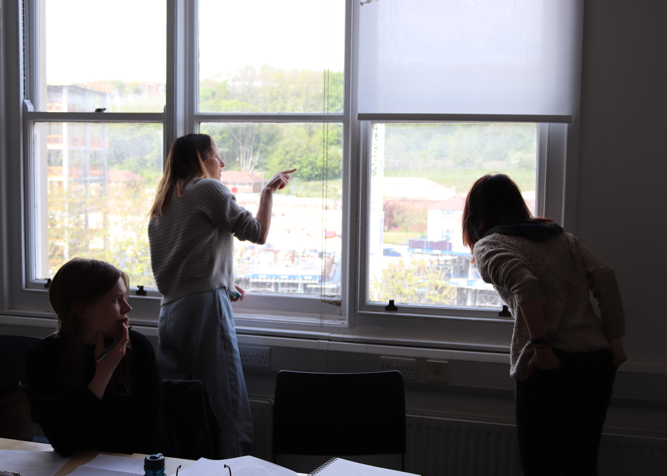
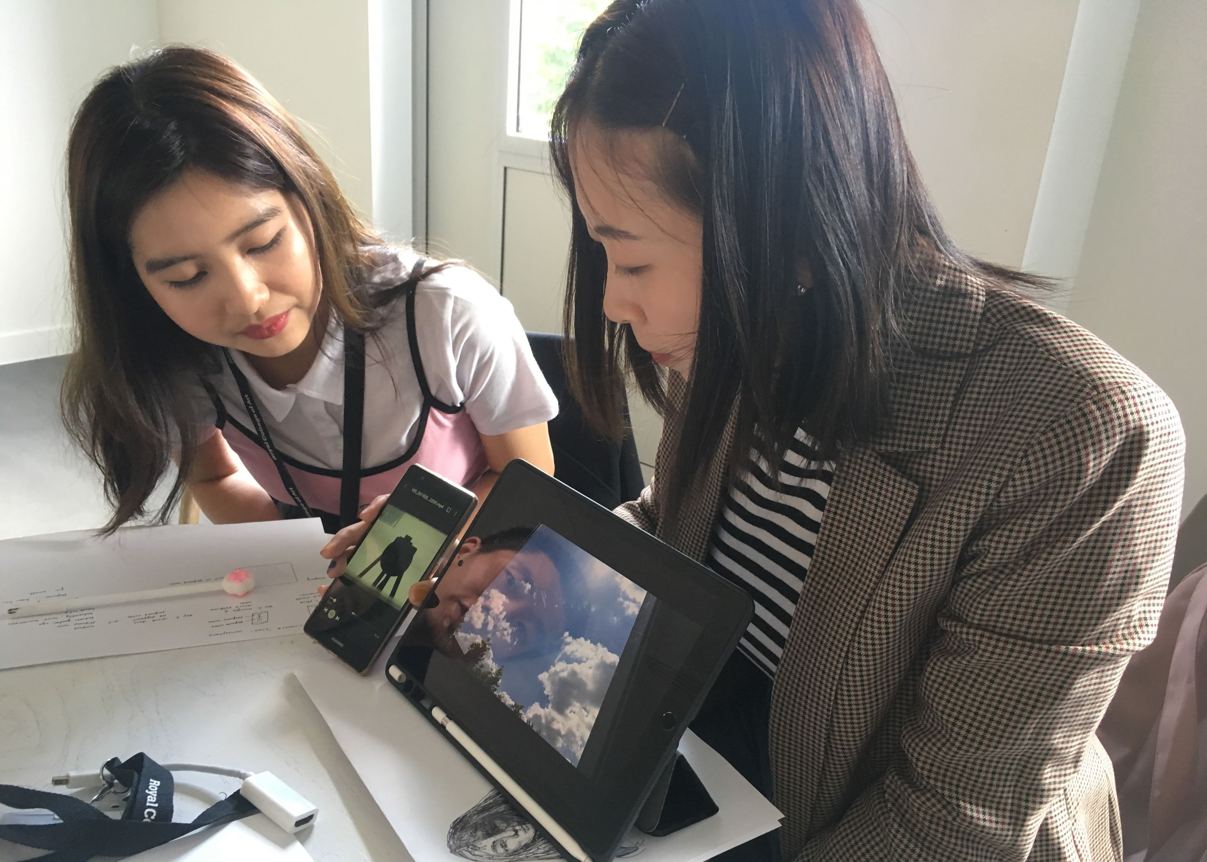
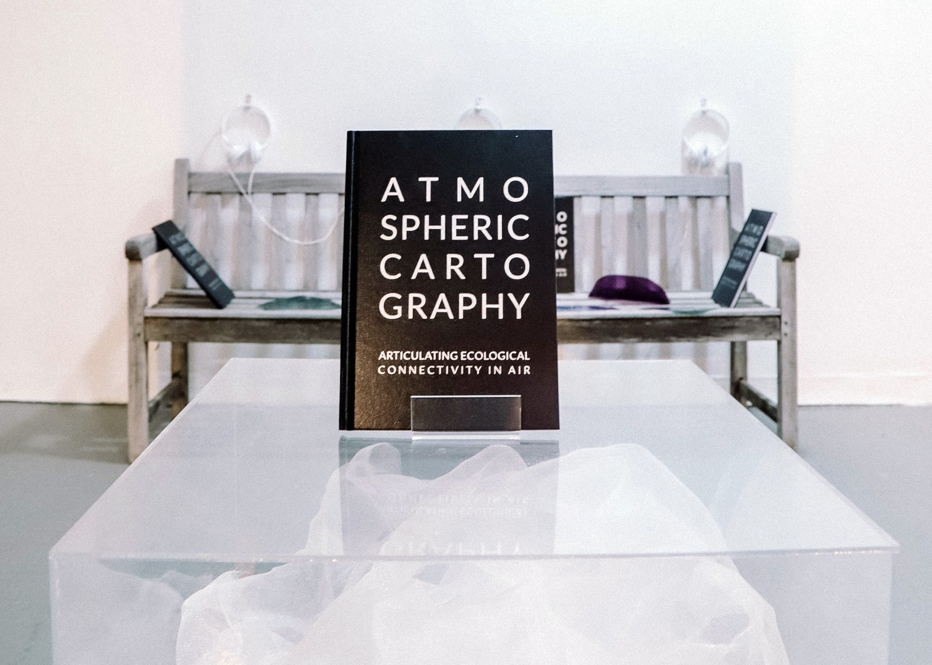
ART SCIENCE
AIR MAPPING
SPACE TIME
BREATH

Slide 4
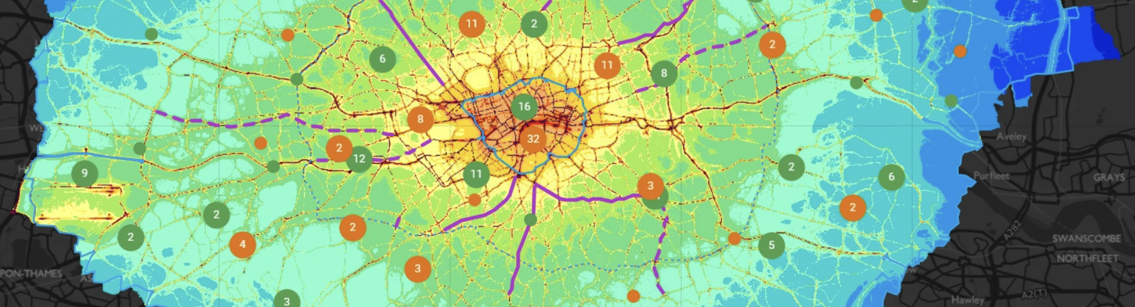
When mapping the spatial distribution of social inequity, an account of air must at some point leave land-based maps, for they can divert us from the movements of air and breathers alike—not to mention mobile pollution sources, such as the taxis, buses, airplanes, and cargo ships crucial to the circulations of Hong Kong’s industries. – Timothy Choy (2011)

Slide 5
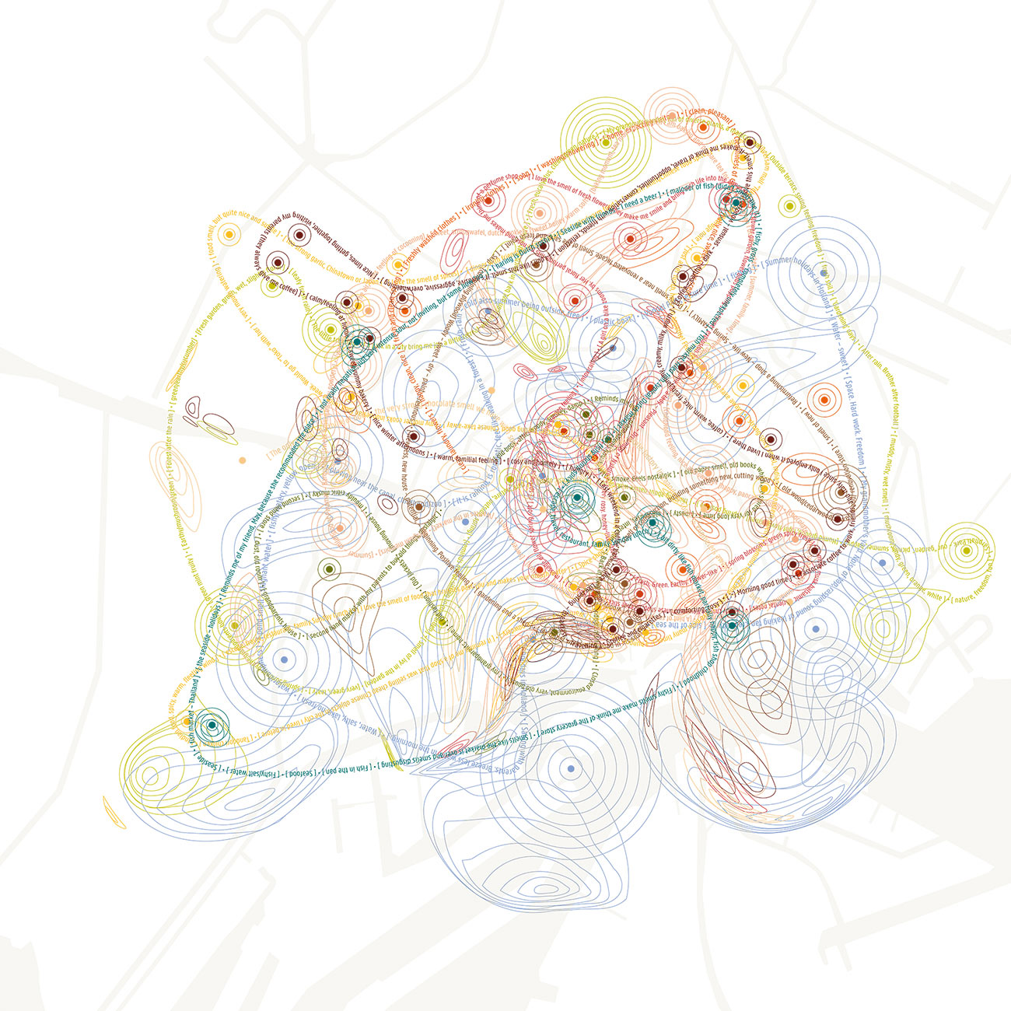
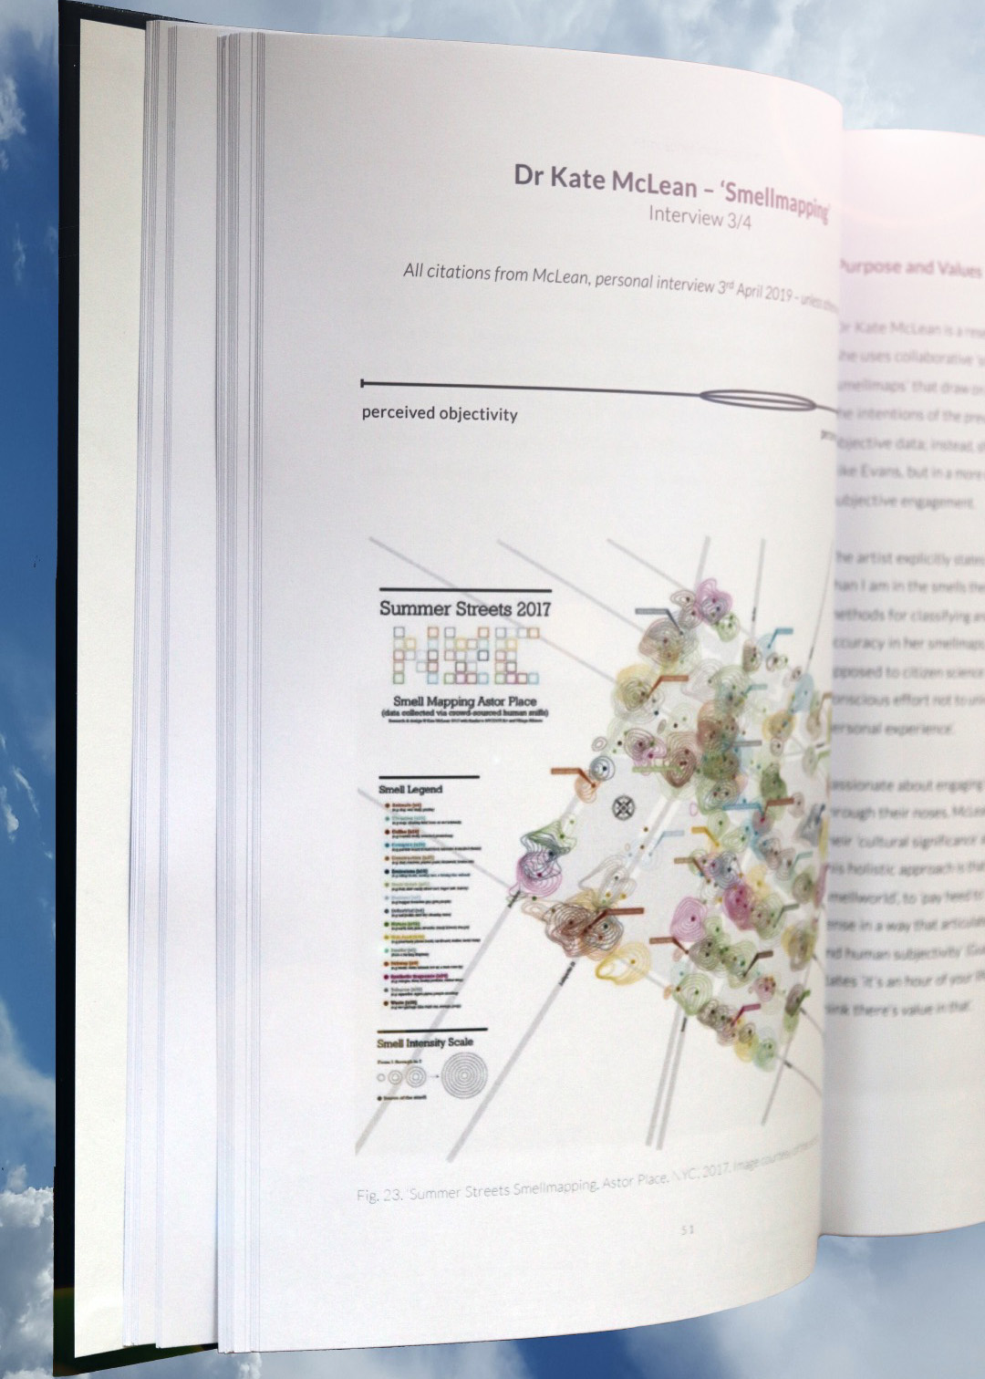
Kate McLean, Amsterdam Smell Map

Slide 6
designing for digital storytelling

Slide 7
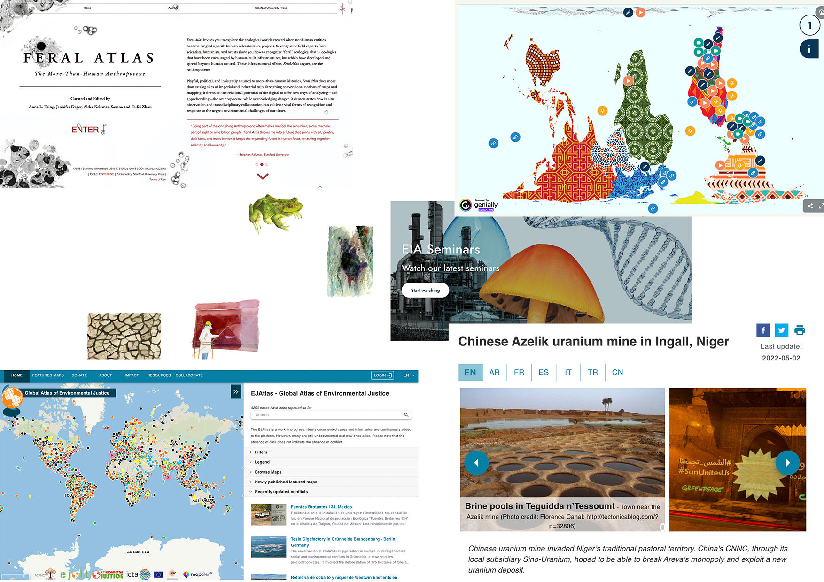
inspiration
inspiration

Slide 8
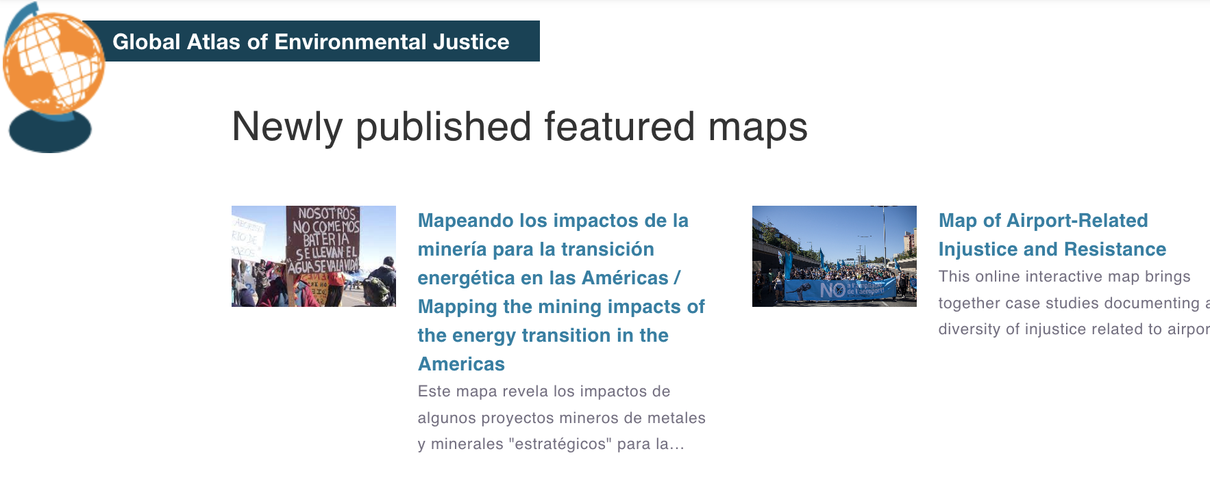
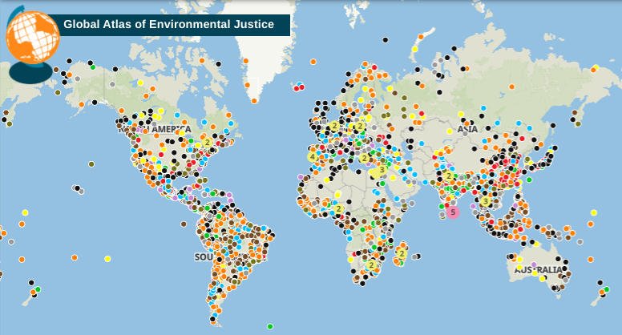
The Global Environmental Justice Atlas (EJAtlas) documents and catalogues social conflicts around environmental issues. It is an online interactive platform coordinated and managed by a team of researchers and activists. The content and data are the result of the work of hundreds of collaborators across the world who tell their own stories of resistance or write about what they witness.
Work-in-progress, community-generated
Navigation features: global map (Mapbox), filters (search fn), filters (fossil fuels, biodiversity conflicts, etc.), featured maps (by country, commodity, company), recent updates
Other features: about, impact (policy, etc.), resources, and collaborate (inc. teaching)

Slide 9
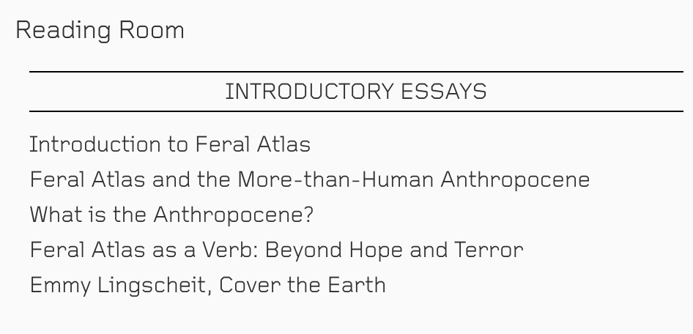
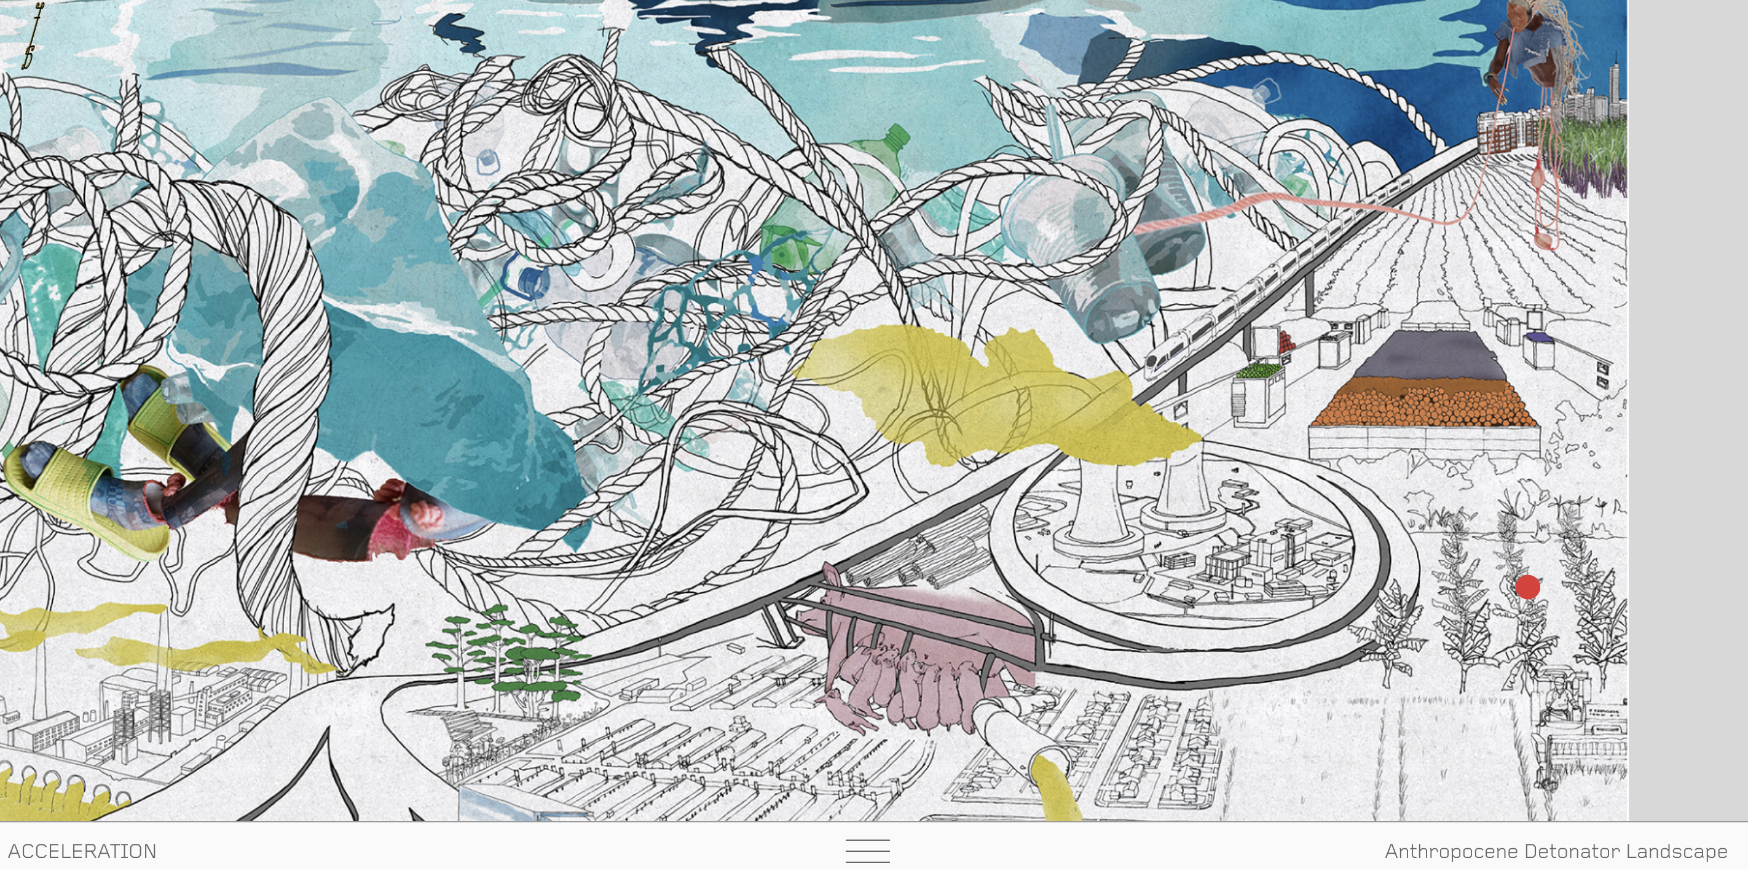
Feral Atlas: The More-Than-Human Anthropocene offers a series of reports on feral ecologies through a digital architecture that allows reflection on the relationships between ferality and imperial and industrial infrastructure
Published by Stanford UP
Feels ‘patchy’ (Tsing)
Book-like, archival, speculative, playful
Maps? Landscapes and collages that play with scale and relations
Navigation: index, clickable animated illustrations, ‘open the drawer’
Can be tricky to navigate all the layers – the ‘reading room’ and actual articles are hidden

Slide 10
forms of visualisation

Slide 11
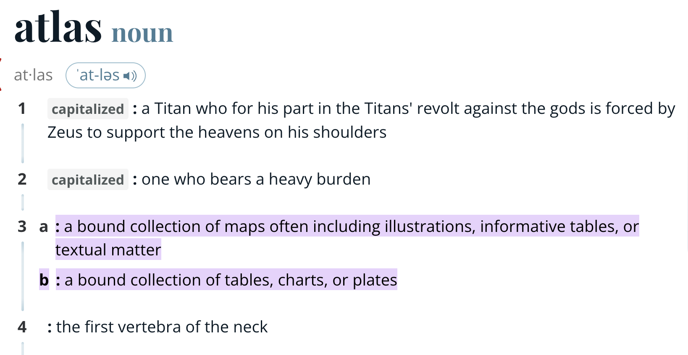

Slide 12
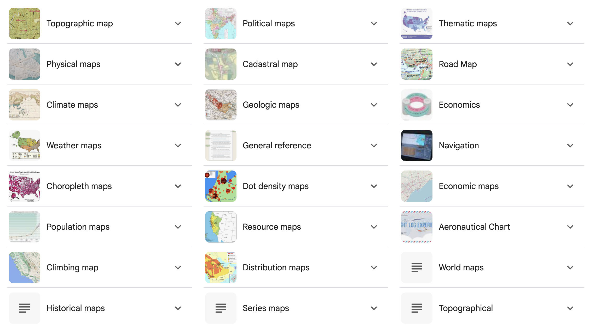
Google search: ‘types of maps’

Slide 13
ways of mapping
Mapping methods differ in and within sciences, social sciences, arts and humanities
Thematic maps are single-topic maps that focus on specific themes or phenomena

Slide 14
ways of mapping
Conventional cartography vs critical cartography
One approach: counter-mapping
Examples include attempts to protect territories, community mapping, and mapping by a relatively weak state to counter the resource claims of a stronger state.
Conceptually, we might think about cartographic imaginaries of the chemical not existing in whitespace, being interscalar (Hecht), having nonlinear temporalities, intimately interweaving bodies and industries…

Slide 15
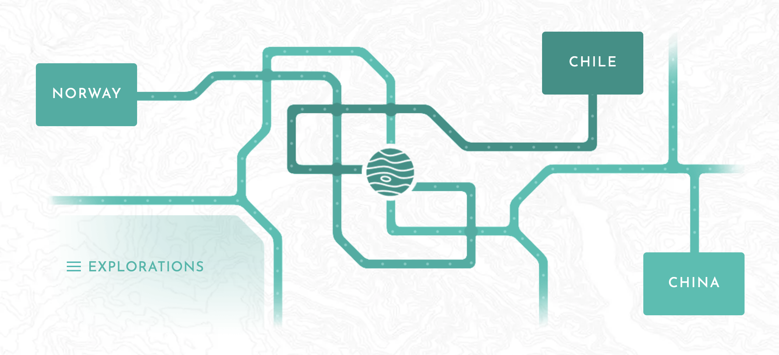
Worlds of Lithium, led by Cristobal Bonelli, UvA

Slide 16
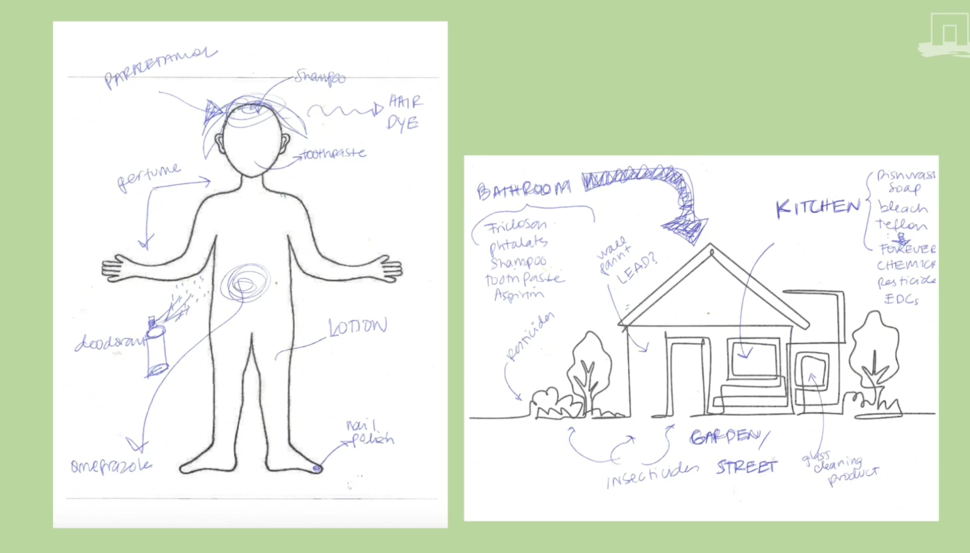
Embodied Ecologies project, led by Anita Hardon, Wageningen

Slide 17
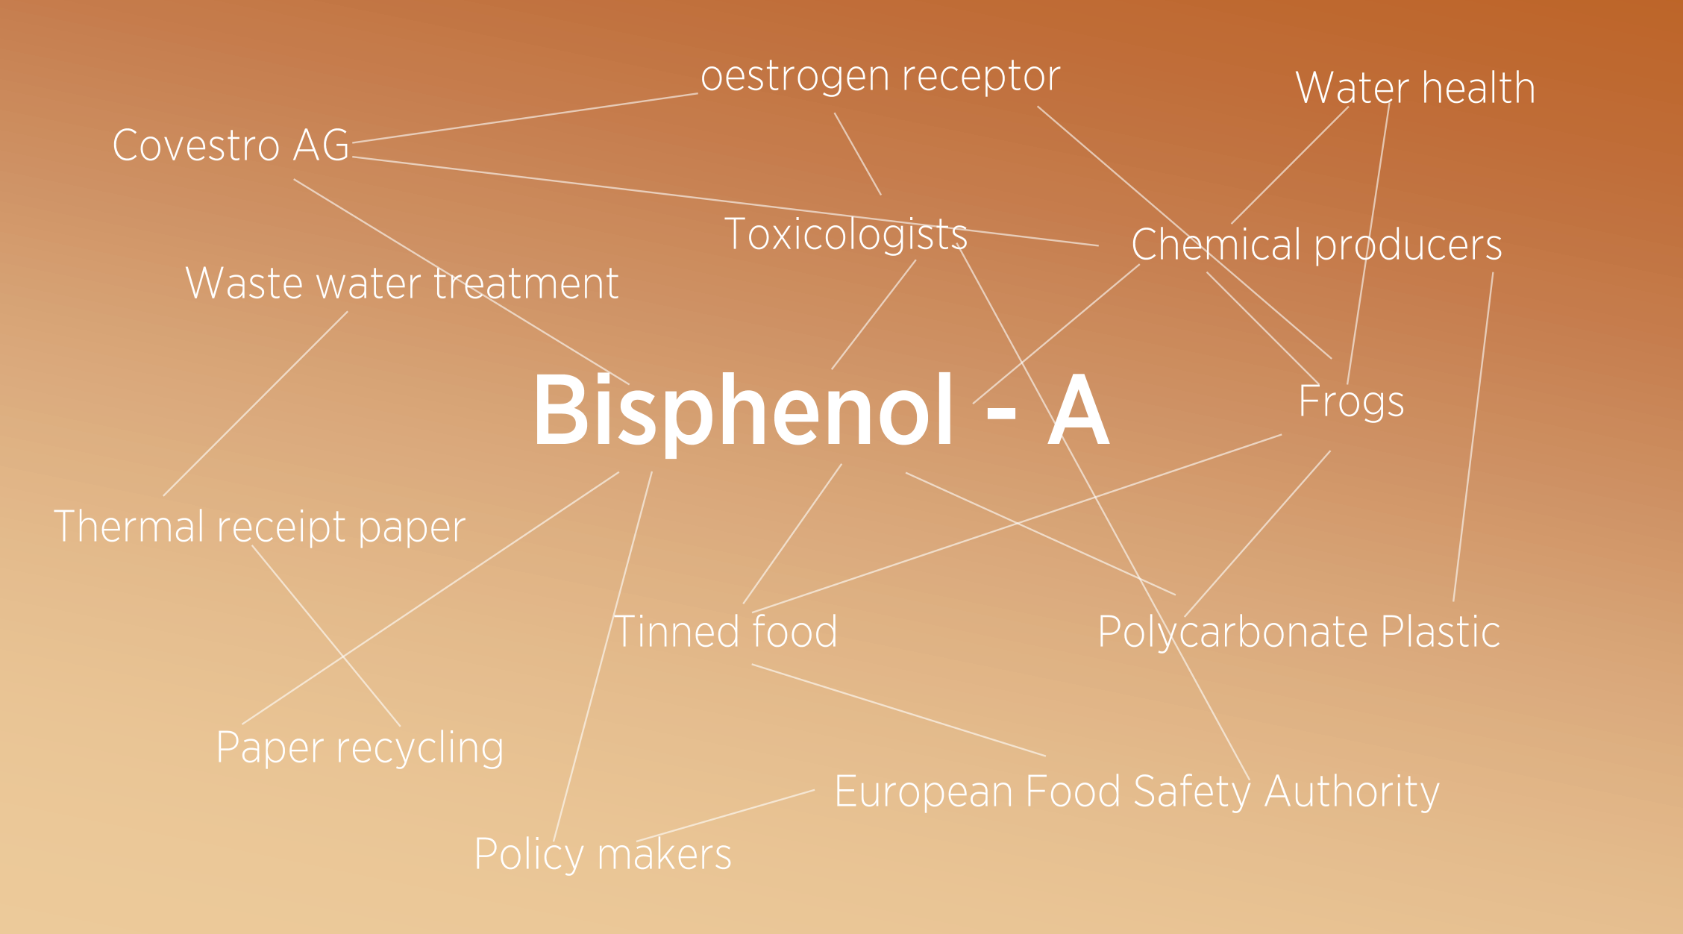
Concept map by artist Jemma Woolmore

Slide 18
Which mapping method or form of visualization appeals to you and why?
Three minutes to reflect and/or sketch an idea.
You can refer to the previous examples or think of your own method.
We will return to these ideas later…

Slide 19
working towards a prototype

Slide 20
user experience is key
the overall experience of a person using a product such as a website or computer application, especially in terms of how easy or pleasing it is to use. (OED)
Tailors content to audience needs
Boosts engagement and action
Ensures accessibility and inclusivity
Builds trust and credibility
Guides effective design and navigation
Supports targeted outreach and growth
Focuses resources efficiently
Enables impact measurement and improvement

Slide 21
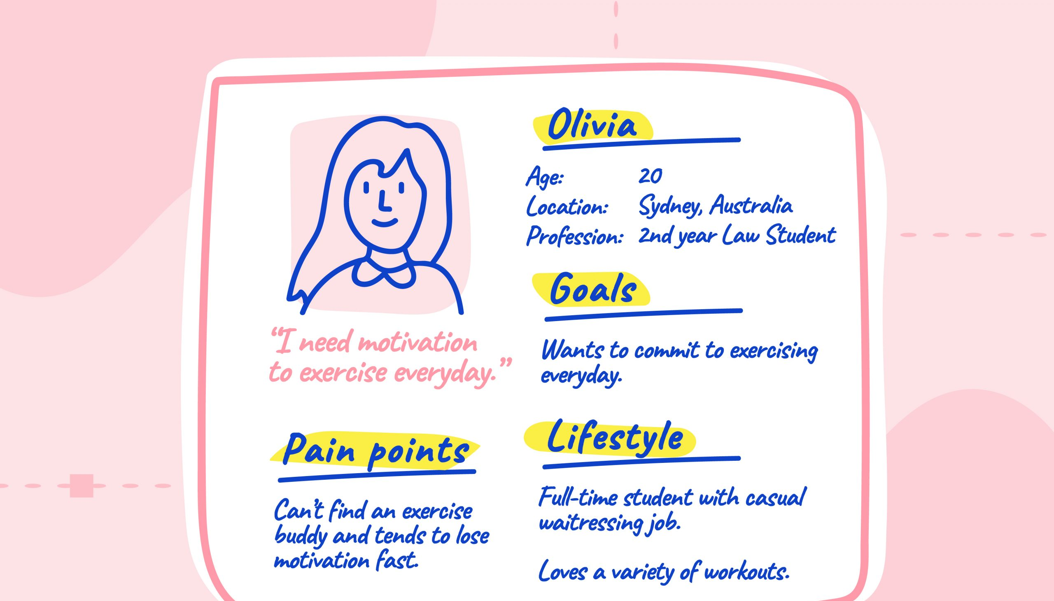
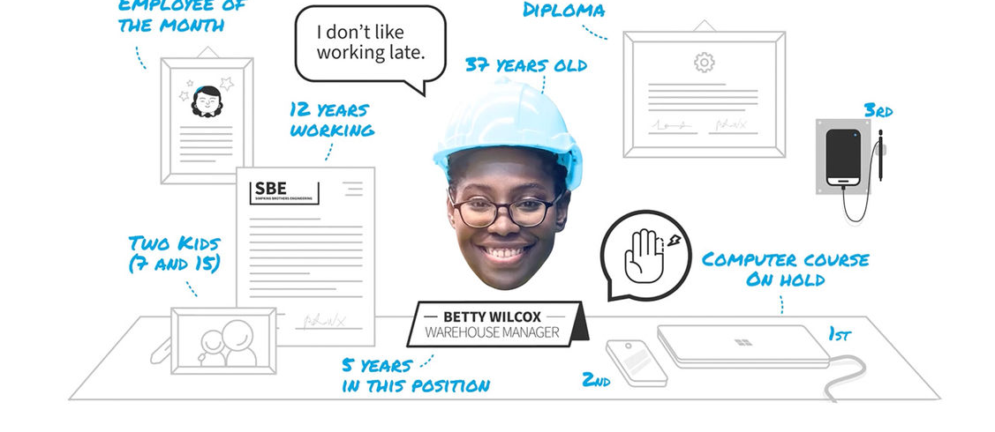
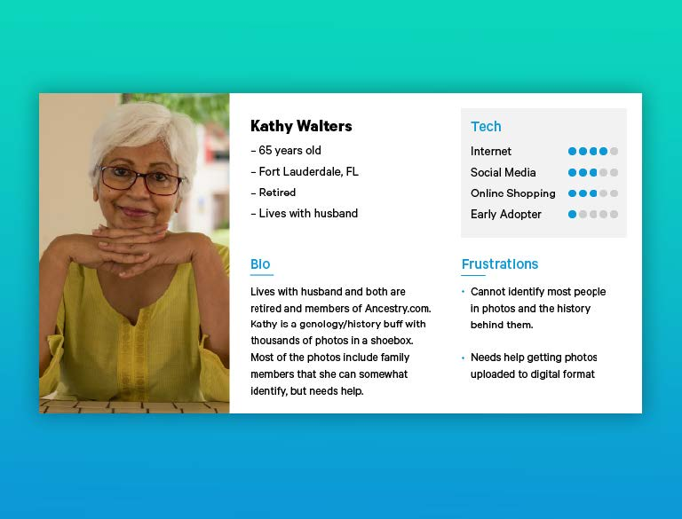

(must have funky glasses)

Slide 22
user persona exercise
Who are they?
Where are they learning about your resource or effort?
Why are they coming to use it, or why would they get involved?
How will they use your resource? Or how will they benefit from getting involved?
What are the questions they might be coming to answer?
Any other details?
Put an x on the line between the two types.
TECHNOCRAT ———————– ACTIVIST
RISK TAKER ————————– CAUTIOUS
FACTS —————————– NARRATIVE
STABILITY ————————- SOCIAL JUSTICE
STRONG STATE ———————– CITIZEN ENGAGEMENT
INDIVIDUAL POWER ———————- COLLECTIVE POWER

Slide 23
Tell us about your persona

Slide 24
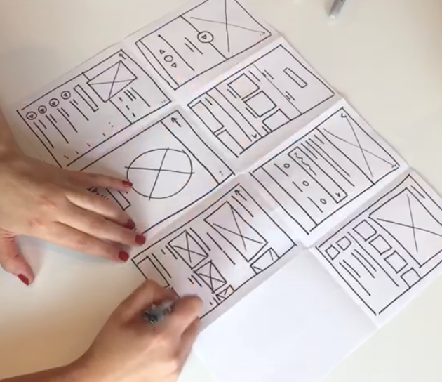
Rapid prototyping / 8 in 8 (crazy 8s) exercise
Take a sheet of A4 and fold to make 8 rectangles
Turn it portrait if you want to design for mobile screens, landscape for desktop monitors / laptops
You have 8 minutes to rapidly sketch 8 designs for the homepage of Chemical Atlas!!
Keep your user personas in mind
P.S. Your sketches don’t need to be perfect or complete wireframes.

Slide 25
What ideas emerged?

Slide 26
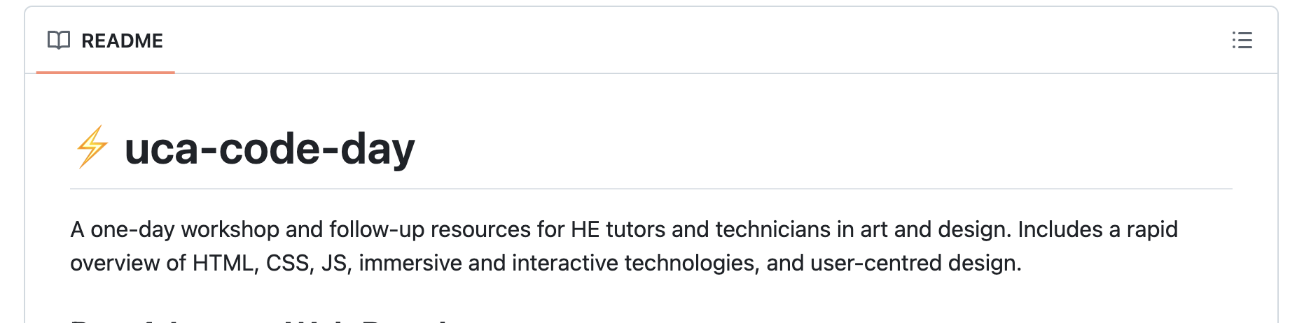
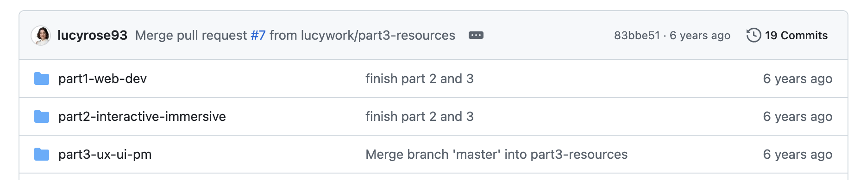
Thanks for participating!
If you’re interested in the methods today, I’ve created a one-day workshop for digital design for academics. See https://github.com/lucywork/uca-code-day

Slide 28
breakout session
Group A
PFAS and persistence/accumulation, mobility
Group B
Plastics, endocrine disruption and reproductive justice
Group C
Mining, colonialism, critical minerals, Africa, S. America
Chemical Atlas Workshop | University College London

Slide 29
Discussion points / activities (optional)
Brief icebreaker (vocal): why did you choose to join this breakout session?
What are the implications of this topic for the Chemical Atlas in terms of its design, audience, and potential? What are some of the challenges? Mind map your ideas as a group.
Select a case study. Make one or more user personas (someone who might be interested in this case study). Sketch a ‘story page’ on Chemical Atlas. Are there subheadings? Images? Videos? Think about the categories (keywords for this topic).
Group reflection. What are you still uncertain or concerned about? What did you discover through creating a prototype?

